Slide 1


Introduction to Git and GitHub
Noel Mc Grath
https://github.com/noelmcgrath/GitPresentation

Slide 2
Agenda
Day 1
Day 2
Getting to know Git
Working with Git locally
Git integration
Git Gui
Visual Studio Tools for Git
Git and TFS
Git and Multimedia
Recap
Working with Git remotely
GitHub
GitHub for Windows
Branching and Merging
Git internals
Resources

Slide 3
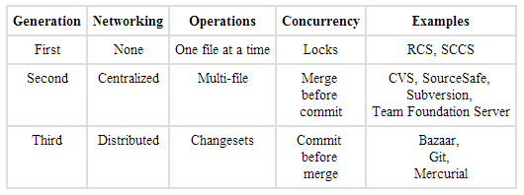
History of Version Control Systems
http://www.ericsink.com/vcbe/html/history_of_version_control.html

Slide 4
Why Use Version Control?
Lecturers
Students
Used in the industry
Software evolution
Track individual and group projects
Not just software
Preparing for work
Sharing and collaboration
Workflow
Rollbacks

Slide 5
Distributed Version Control Systems (DVCS for short)
Full history on local repository
You commit changes to your own repository
The owner of the official repository can pull those changes
Can have a centralised repository that all contributors can push to
Branching/merging reliable and easy
Backups are easy – each clone is a full backup
Deployments - heroku
Notes:
Draw difference between central and distributed

Slide 6
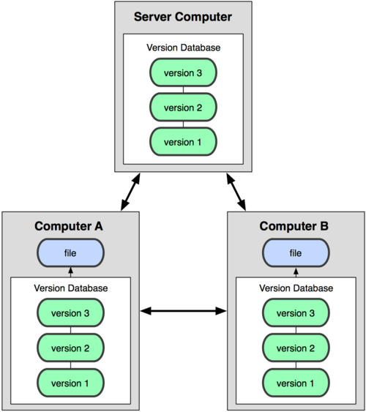

Centralized Versus Distributed Version Control Systems
Notes:
Draw difference between central and distributed

Slide 7
Git
Created by Linus Torvalds for Linux kernel development in 2005
Linux fell out with BitKeeper
Free and open source
Runs on many OS’s
Handle small to large projects
Fast performance
Cheap local branching
Simplicity
No network required
Immutable
Not like others

Slide 8
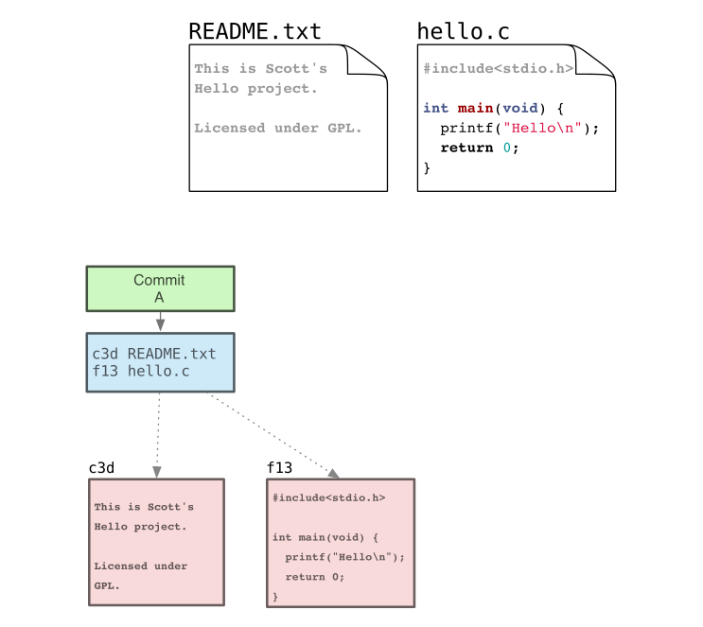

Slide 9
Command Line or GUI?
GUI and IDE options
Git Gui
TortoiseGit
Git Extensions
SourceTree
Visual Studio Tools for Git
GitHub on Windows
posh-git
Egit – Eclipse
Many more …..

Slide 10
Installation On Windows
http://msysgit.github.io/
Configure Git
Levels
System
User
Repository

Slide 11
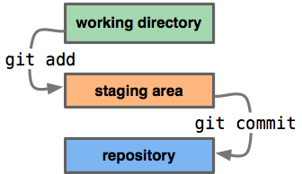
Our First Repository
Creating a repository
Adding files and committing
Making changes and diffs
Viewing history
Refactoring and viewing diffs
Ignoring files using .gitignore
Demo

Slide 12
Common Git Commands
Task | Command
Create repository | git init
Add file(s) | git add <filename> git add .
Commit changes | git commit -m "Commit message"
Check status | git status
View history | git log git log -10 git log --name-only
View changes | git diff git diff <sha1> <sha2>
Undo changes | git checkout .

Slide 13
Git and Team Foundation Server (TFS)
Team Foundation Server (TFS) isn't just source control, it's a whole bug tracking, change management, application lifecycle management (ALM) suite. Source control is one pluggable piece.
Support for Git since Visual Studio 2012 Update 3
http://visualstudiogallery.msdn.microsoft.com/abafc7d6-dcaa-40f4-8a5e-d6724bdb980c
Git available by default in Visual Studio 2013

Slide 14
Git and multimedia files
Not designed for this
Inefficient as wont do incremental diffs for binary files
Use other tools
git-annex
perforce
commercial products

Slide 15
Git Integration
Git Gui
Visual Studio Tools
GitHub on Windows
Posh-git

Slide 16
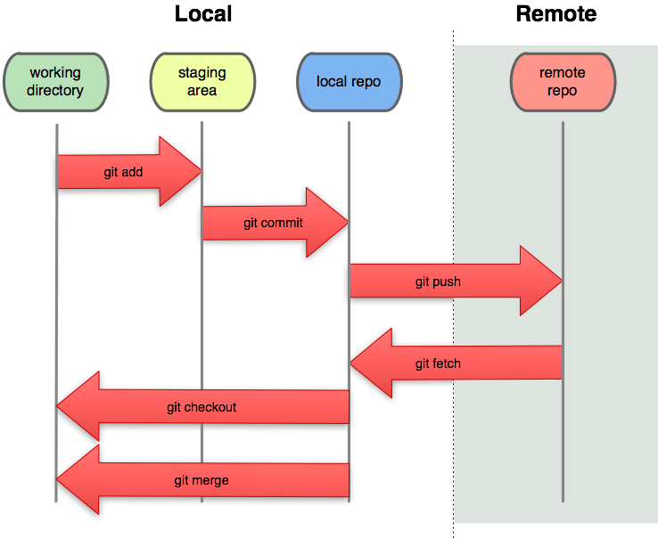
Working With Remote Repository
Cloning
Listing repositories
Fetching and Merging
Pulling
Pushing changes
Tags
Demo

Slide 17
More Git Commands
Task | Command
Clone a repository | git clone <repository url>
View history | git log –graph git shortlog
Show changes | git show <sha>
Show remote repository | git remote git remote -v
Add remote | git remote add origin <repository url>
Push changes to remote | git push git push origin master
Pull changes to remote | git pull git pull origin master
List branches | git branch
Create branch | git checkout -b <branchname>
Switch to branch | git checkout <branchname>

Slide 18
Branching and Merging
Local branches
Stashing changes
Merging branches
Remote branches
Demo

Slide 19
GitHub
Git repository hosting service – not just software
Largest code host on the planet with over 12.6 million repositories
Free accounts for public repositories
Paid plans for private repositories
Provides access control and several collaboration features
“forking” functionality
Notes:
Features – wiki, task management, graphs, code review etc

Slide 20
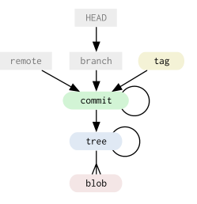
Git internals
When Git stores a new version of a project
it stores a new tree
A bunch of blobs of content and a
collection of pointers that can be expanded
back out into a full directory of files and
subdirectories

Slide 21
Git internals
Four main objects types in Git
Blob
Tree
Commit
Tag

Slide 22
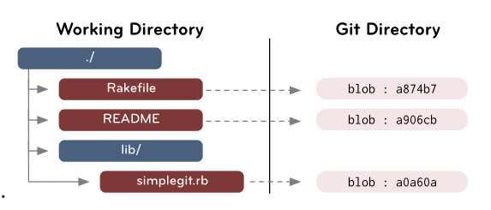
Blob
Contents of files

Slide 23
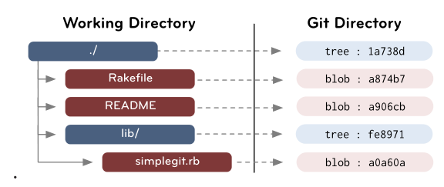
Tree
Directories
List of trees and blobs that the tree contains, along with the names and modes of those trees and blobs

Slide 24
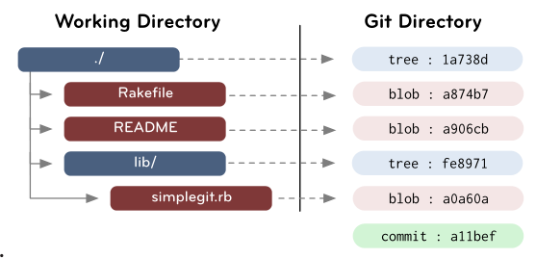
Commit
Points to a tree and keeps an author, committer, message and any parent commits that directly preceded it

Slide 25
Tag
Permanent shorthand name for a particular commit

Slide 26
Resources
Pro Git http://git-scm.com/book
GIT IMMERSION http://gitimmersion.com/lab_01.html
git ready http://gitready.com
Introduction to Git with Scott Chacon of GitHubSearch
Git Internals https://github.com/pluralsight/git-internals-pdf
Search

